Slide 1
Resilient packet ring

Slide 2
Resilient packet ring
IEEE 802.17 resilient packet ring (RPR)
  RPR targets metro edge & metro core areas
  RPR aims at combining
    SONET/SDH’s carrier-class functionalities of high availability, reliability, and profitable TDM service (voice) support
    Ethernet’s high bandwidth utilization, low equipment cost, and simplicity
  RPR vs. SONET/SDH & Ethernet
    Similar to SONET/SDH rings, RPR provides fast recovery from single link or node failure within 50 ms & carries legacy TDM traffic with high-level QoS
    Similar to Ethernet, RPR exhibits improved bandwidth utilization due to statistical multiplexing
    Unlike SONET/SDH rings, RPR utilizes full ring bandwidth under normal (failure-free) operation
    Unlike Ethernet, RPR provides fairness

Slide 3
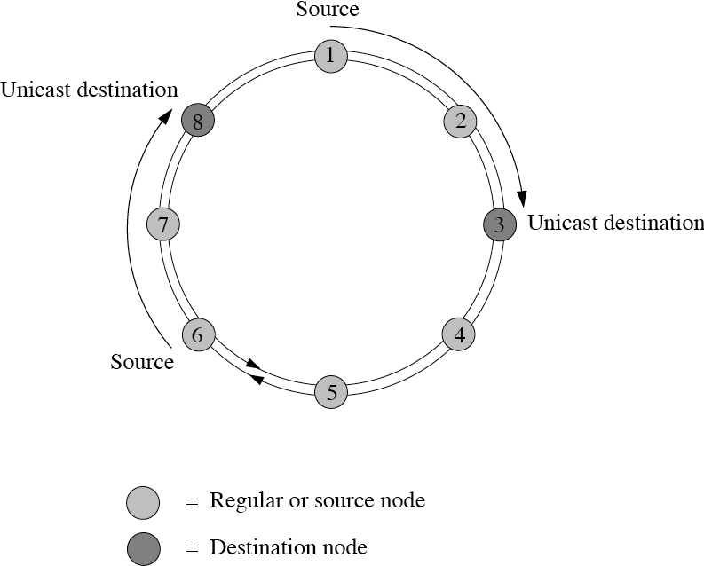
Resilient packet ring
Architecture
  Bidirectional packet-switched ring with counterrotating fiber ringlets 0 and 1
  Up to 255 ring nodes
  RPR MAC over several physical layers (e.g., Ethernet, SONET/SDH)
  Shortest path routing unless preferred ringlet specified by MAC client
  Destination stripping enables spatial reuse => increased capacity

Slide 4
Resilient packet ring
Packet forwarding
  Intermediate nodes forward packet if they don’t recognize destination MAC address in packet header
  Forwarding methods
    Cut-through
      Packet forwarded before completely received
    Store-and-forward
      Packet forwarded after completely received
  Supplementary 1-byte time-to-live (TTL) field
    Added to each packet by RPR MAC control entity
    Value decremented by each intermediate node
    Prevents packets with unrecognized destination MAC address from circulating forever

Slide 5
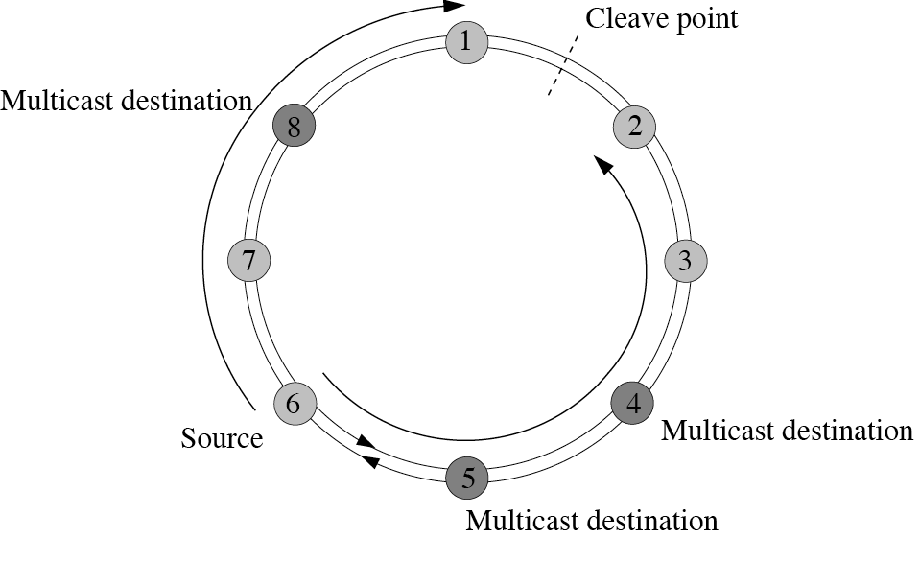
Resilient packet ring
Multicasting
  Multicast group member-ship identified by group MAC destination address
  Realized by means of broadcasting => no spatial reuse
  Unidirectional flooding
    Packet removal based on expired TTL or matching source MAC address
  Bidirectional flooding
    Packets removal at cleave point based on expired TTL
    Cleave point can be put on any span

Slide 6
Resilient packet ring
Topology discovery
  RPR’s topology discovery protocol determines connectivity, order of nodes, and status of each link
  At system initialization
    All nodes broadcast topology discovery control packets on both ringlets with TTL value equal to 255 (maximum number of nodes)
    Each topology control packet contains information about status of corresponding node & its attached links
    By receiving all topology control packets, each node is able to compute complete topology image (number & ordering of nodes, status of each link)
    Topology image is stored in topology database of each node

Slide 7
Resilient packet ring
Topology discovery
  During normal operation
    Topology discovery packet is sent immediately by a
      New node inserted into ring
      Node after detecting link/node failure
      Node after receiving topology discovery packet inconsistent with its current topology image
    Ripple effect
      First node noticing a topology change sends topology discovery packet, followed by all other nodes
    Consistency check
      Once topology image is stable for specified time period, each node performs consistency check
    Robustness
      After achieving stable & consistent topology image, each node continues to periodically send topology discovery packets

Slide 8
Resilient packet ring
Topology discovery
  Use of topology database
    Determining number of hops between source & destination nodes
    Setting TTL field to appropriate value
    Selecting shortest path to any destination node

Slide 9
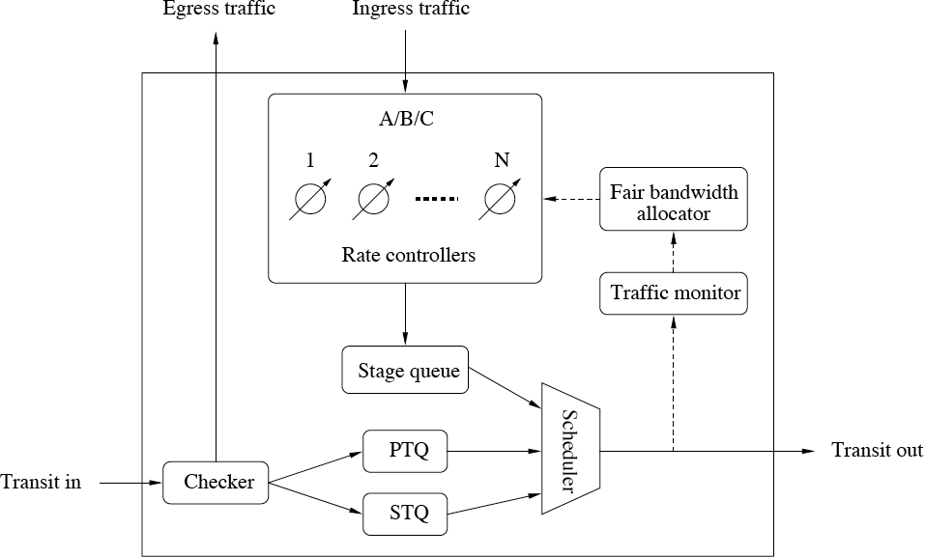
Resilient packet ring
Node architecture

Slide 10
Resilient packet ring
Node architecture
  Salient features
    Virtual output queueing (VOQ) to avoid head-of-line (HOL) blocking
    Ingress traffic throttled by means of token bucket traffic shapers
    Lossless transit path
      Single-queue mode
        Single FIFO queue called primary transit queue (PTQ) to store class A in-transit traffic
      Dual-queue mode
        Additional FIFO queue called secondary transit queue (STQ) to store class B & C in-transit traffic
      RPR network may consist of both single-queue & dual-queue nodes
    Checker, scheduler, and traffic monitor

Slide 11
Resilient packet ring
Traffic classes
  Class-based priority scheme to achieve QoS support & service differentiation
  Traffic classes & subclasses
    Class A: Low-latency & low-jitter service with guaranteed bandwidth
    Class B: Predictable latency & jitter service
    Class C: Best-effort
Traffic class | Subclass | Bandwidth preallocation
A | A0 A1 | Reserved Reclaimable
B | B-CIR B-EIR | Reclaimable No preallocation
C | - | No preallocation

Slide 12
Resilient packet ring
Bandwidth preallocation
  To fulfill service guarantees, bandwidth preallocated for traffic subclasses A0, A1, and B-CIR
    Subclass A0
      Reserved bandwidth
      Reservation done by using topology discovery protocol
      Reserved bandwidth dedicated to node making reservation
    Subclasses A1 & B-CIR
      Part of unreserved bandwidth preallocated to subclasses A1 & B-CIR => reclaimable bandwidth
      Reclaimable bandwidth not used by A1 & B-CIR (as well as remaining unreserved bandwidth) can be used by subclasses B-EIR & C
    Subclasses B-EIR & C
      No bandwidth preallocation
      Fairness eligible traffic

Slide 13
Resilient packet ring
Access control
  Single-queue mode
    Highest priority given to local control traffic if PTQ not full
    Without local control traffic, in-transit traffic is given priority over local ingress traffic
  Dual-queue mode
    Highest priority given to local control traffic if both PTQ & STQ not full
    Without local control traffic, PTQ always served first
    If PTQ empty, local ingress traffic served until STQ reaches certain threshold
    If STQ threshold crossed, STQ in-transit traffic is given priority over local ingress traffic
  Benefits
    Lossless transit path for all traffic classes
    Class A traffic experiences only propagation delay & occasional queueing delay due to nonpreemptive scheduling

Slide 14
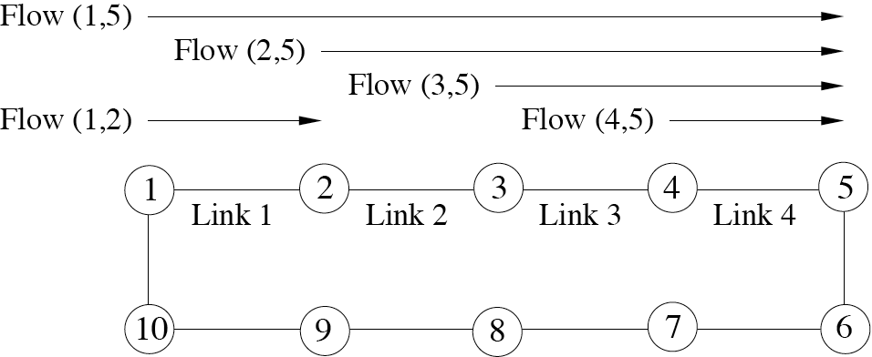
Resilient packet ring
Fairness control
  Lossless path property gives rise to starvation of down-stream nodes => fairness problem
  Distributed fairness control protocol
    Dynamically throttling upstream traffic
    Maximizing spatial reuse

Slide 15
Resilient packet ring
RIAS reference model
  Fairness control designed according to ring ingress aggregated with spatial reuse (RIAS) reference model
  RIAS reference model
    Fairness on each link is determined at granularity of ingress aggregated (IA) flow (only traffic subclasses B-EIR & C)
    IA flow: aggregate of all flows originating from a given ingress node
    Goals
      Throttle IA flows at ring ingress nodes to their network-wide fair rates => alleviated congestion
      Let unused bandwidth be reclaimed by IA flows => maximized spatial reuse
    Fairness control realized by backlogged nodes sending fairness control packets based on local measurements to upstream ring nodes

Slide 16
Resilient packet ring
Fairness control algorithm
  Framework
    Each node measures forward_rate & add_rate as byte counts at output of scheduler
      Forward_rate: serviced rate of all in-transit traffic
      Add_rate: serviced rate of all local traffic
    Both traffic measurements are
      taken over prespecified time period called aging_interval
      low-pass filtered by means of exponential averaging using parameter 1/LPCOEFF for current measurement & 1 - 1/LPCOEFF for previous average
    Measurements are used by nodes to detect local congestion
    When node n is congested, it calculates its local_fair_rate[n]
    Congested node n sends fairness control packet containing local_fair_rate[n] to upstream nodes
    Upstream nodes sending via n throttle their traffic to fair rate
    When congestion clears, all nodes periodically increase rate

Slide 17
Resilient packet ring
Local_fair_rate
  Local_fair_rate[n] of congested node n denotes fair rate at which source nodes are supposed to transmit via intermediate node n
  Congested node n sends fairness control packet containing local_fair_rate[n] to upstream node n-1
  If node n-1 is also congested, it forwards fairness control packet to upstream node n-2 containing min {local_fair_rate[n], local_fair_rate[n-1]}
  If node n-1 is not congested but its forward_rate > local_fair_rate[n], it forwards fairness control packet to upstream node n-2 containing local_fair_rate[n]
  Otherwise, node n-1 sends null-value fairness control packet to indicate lack of congestion

Slide 18
Resilient packet ring
Allowed_rate_congested
  When upstream node i receives fairness control packet with local_fair_rate[n], it decreases rate controller value of all flows traversing congested node n to allowed_rate_congested
  Allowed_rate_congested equals sum of serviced rates of all flows (i,j) originating from node i & traversing node n on their path toward destination node j => local traffic rates of upstream node i does not exceed local_fair_rate[n]
  Otherwise, if upstream node i receives null-value fairness control packet, it increases allowed_rate_congested by prespecified value to reclaim bandwidth

Slide 19
Resilient packet ring
Operation modes
  Fairness control algorithm operates in either of two operation modes
    Aggressive mode (AM)
    Conservative mode (CM)
  Both AM & CM operate within the same aforementioned framework
  AM & CM differ in how node detects congestion & calculates its local fair rate

Slide 20
Resilient packet ring
Aggressive mode (AM)
  AM is default operation mode of RPR deploying dual-queue mode
  Operation
    Node n is considered congested whenever
      STQ_depth[n] > low_threshold
    or
    forward_rate[n] + add_rate[n] > unreserved_rate
    A congested node n calculates its local_fair_rate[n] as the serviced rate of local traffic add_rate

Slide 21
Resilient packet ring
Conservative mode (CM)
  CM deploys single-queue mode by default
  Each node uses access timer
  Operation
    Node n is considered congested whenever access timer expires or
    forward_rate[n] + add_rate[n] > low_threshold
    If node n is congested only in current aging_interval:
    local_fair_rate[n] = unreserved_rate/# of active nodes
    If node n is continuously congested:
      local_fair_rate[n] ramps up if
      forward_rate[n] + add_rate[n] < low_threshold
      local_fair_rate[n] ramps down if
        forward_rate[n] + add_rate[n] > high_threshold

Slide 22
Resilient packet ring
Protection
  Due to bidirectional dual-fiber ring topology, RPR is able to recover from single link or node failure
  Fault detection
    Alarm signal issued by underlying physical layer technology (e.g., loss-of-signal (LOS) alert in SONET/SDH)
    No keep-alive messages from neighboring node for pre-specified period of time
  Fault notification
    Upon fault detection, node broadcasts topology discovery update packet to inform all ring nodes about failure
  Fault recovery
    RPR deploys two protection techniques
      Wrapping (optional)
      Steering (mandatory)

Slide 23
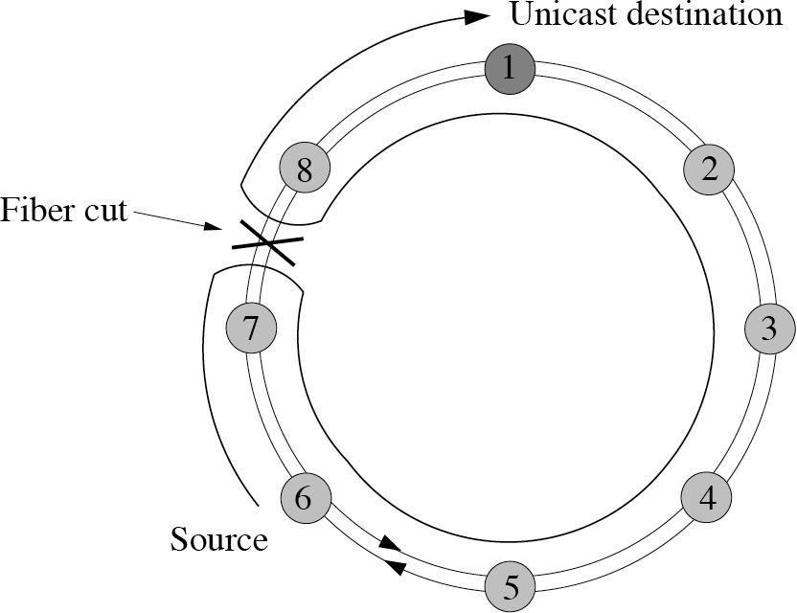
Resilient packet ring
Wrapping
  Optional in RPR
  If deployed, all nodes must support it
  Similar to automatic protection switching (APS) of SONET/SDH self-healing rings (SHRs)
  Affects only packets marked wrap eligible (we bit in header is set)
  Benefits
    Fast recovery time
    Minimized packet loss
  Drawback
    Bandwidth inefficiency

Slide 24
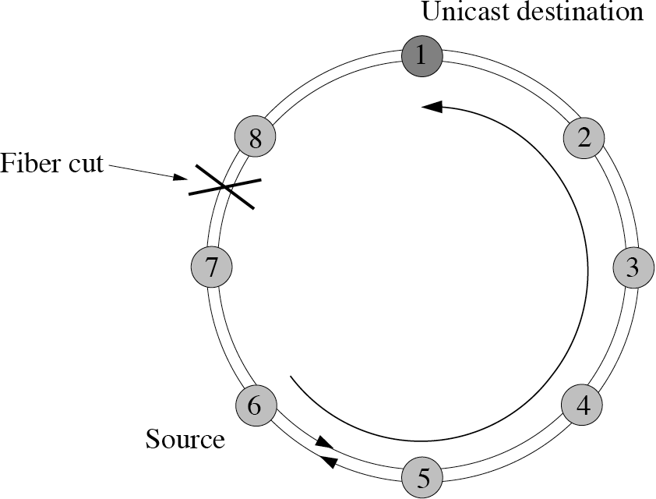
Resilient packet ring
Steering
  Mandatory in RPR
  After receiving a topo-logy discovery update packet sent by wrapping node, a source node sends local ingress traffic on the ringlet in failure-free direction
  Benefit
    Higher bandwidth efficiency than wrapping
  Wrap-then-steer protection strategy
    recommended if both wrapping & steering used together => packet reordering

Slide 25
Resilient packet ring
In-order delivery
  RPR deploys two packet modes
    Strict packet mode (default)
      Packets guaranteed to arrive in same order as sent
      Strict order (so) bit in header is set to identify strict order packets
      Strict order packets cannot be marked wrap eligible => discarded at wrap point
      After learning about failure, nodes stop sending strict order packets & discard strict order in-transit packets until topology stabilization timer expires
      With stable & consistent updated topology image, nodes start to steer strict order packets onto respective ringlet
    Relaxed packet mode (optional)
      Relaxed packets may be steered immediately after learning about failure & are not discarded from transit queues

